Slide 1
Application security: users and roles

Slide 2
application.properties
security #spring.security.user.name=user #spring.security.user.password=password

Slide 3
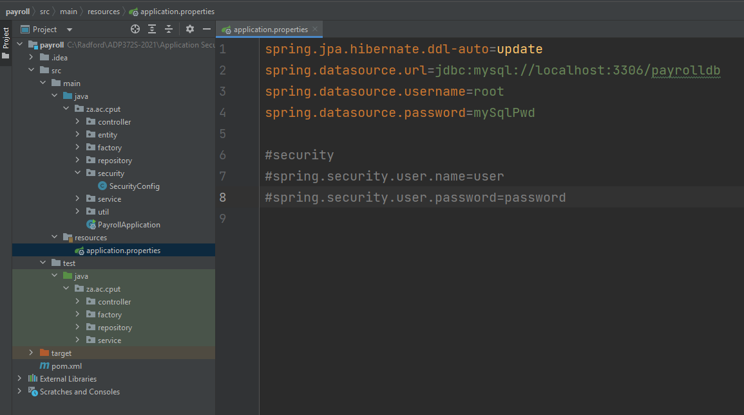
security.SecurityConfig

Slide 4
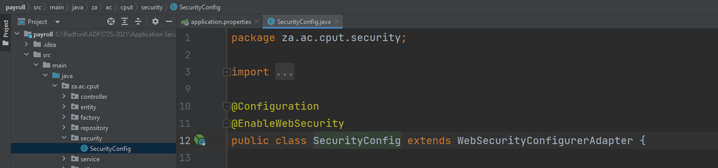
security.SecurityConfig

Slide 5
security.SecurityConfig
Right-click on class-name > generate > override methods
Select 2 methods:
configure(AuthenticationManagerBuilder auth) – configures user credentials
configure(HttpSecurity http) – configures required urls or endpoints

Slide 6
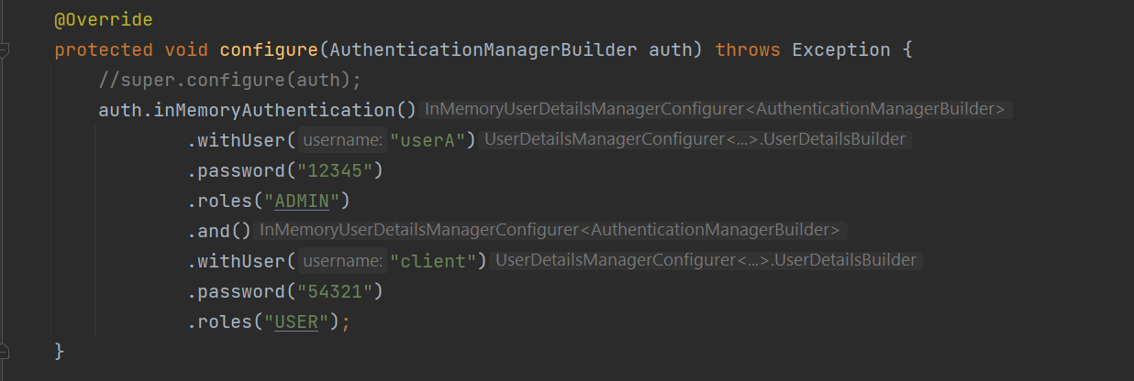
security.SecurityConfig:
Override method: configure(AuthenticationManagerBuilder auth)
Match user with role
Match user with role

Slide 7
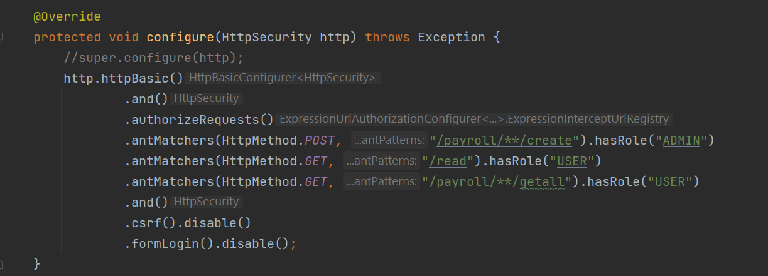
security.SecurityConfig:
Override method: configure(HttpSecurity http)
define endpoints for each of the roles, to specify who has access to different functionality
Assign functionality to role

Slide 8
Run application
When we run the application, an error occurs: password needs to be encoded.
{noop} - Spring security provides a password encoder that does nothing. Useful for testing where working with plain text passwords may be preferred.

Slide 9
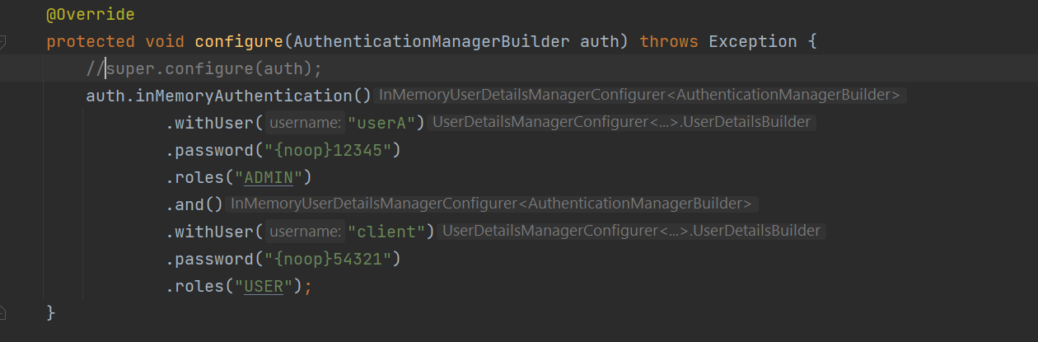
security.SecurityConfig:
Override method: configure(AuthenticationManagerBuilder auth)

Slide 10
Run application again
Application should run successfully.
Postman> run getAll with BasicAuth for Client
> run create with BasicAuth for Client : should get error message ‘Unauthorized’
> run create with BasicAuth for ADMIN : should work
Postman session will hold on to authentication details, so you will have to close Postman and restart to test different roles.

Slide 11
Password encoding
is basically not storing the password in plaintext.
There are a few encoding mechanisms supported by Spring Security.
BCrypt is usually the best solution available.
Most of the other mechanisms, such as the MD5PasswordEncoder and ShaPasswordEncoder,
use weaker algorithms and are now deprecated

Slide 12
Password encoding
In SecurityConfig class, add another method with a tag:
@Bean
public PasswordEncoder encoder(){
return newBCryptPasswordEncoder() // The preferred implementation
}

Slide 13
Password encoding
in configure(AuthenticationManagerBuilder auth) :
auth.inMemoryAuthentication()
.withUser(“userA”)
.password(encoder().encode( “12345”))
.roles(“ADMIN”) - matches a user with a role.
.and()
.withUser(“client”)
.password(encoder().encode(“54321”)
.roles(“USER”);

Slide 14
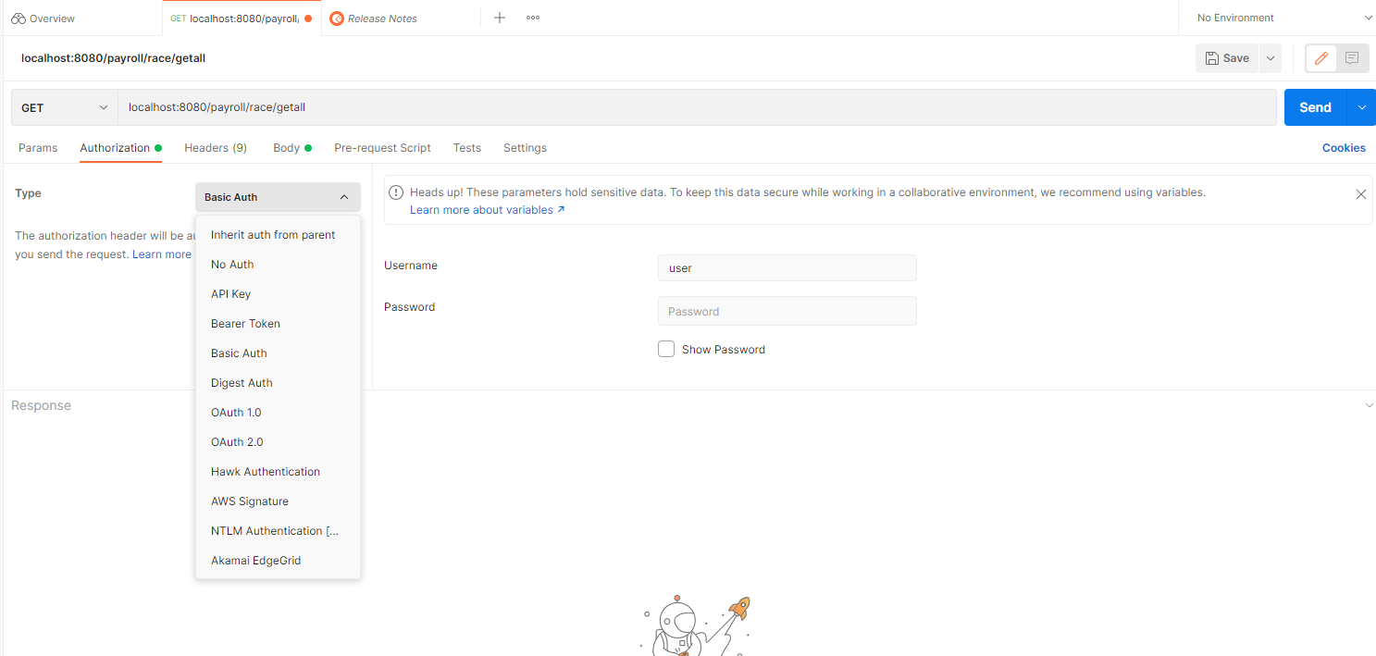
Run application again
Application should run successfully.
Run Postman and test endpoints and authorization for different users/roles

Slide 15
Note: class WebSecurityConfigurerAdapter has been deprecated.
spring.io/blog/2022/02/21/spring-security-without-the-websecurityconfigureradapter
Please read the link provided here to see details on the class and methods that have since replaced WebSecurityConfigurerAdapter.

